Slide 1
DAH2F3 Perencanaan Sumber Daya Perusahaan
Minggu ke-2: Proses Bisnis dan Area Fungsional
P r o d i D 3 K o m p u t e r i s a s i A k u n t a n s i F I T , U n i v e r s i t a s T e l k o m

Slide 2
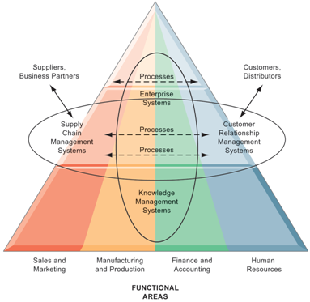
Area Fungsional (Fungsional Area)
Adalah pengelompokan kegiatan atau proses atas dasar kebutuhan mereka dalam mencapai satu atau lebih tugas.
Area fungsional = nama departemen
(Rainer and Cegielski 2012, 42).
Area Fungsional

Slide 3
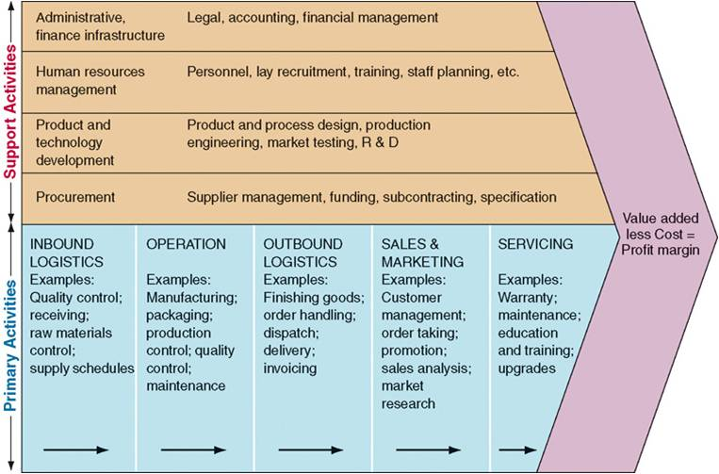
Area fungsional utama dalam Operasi Bisnis, yaitu:
1
Accounting and Finance (A/F)
2
Human Resources (HR)
3
Supply Chain Management(SCM)
4
Marketing and Sales (M/S)
Value Chain Potter.
Sumber: http://info563.malagaclasses.info/wp-content/uploads/2012/05/The-Value-Chain-Porter1.jpg

Slide 4
Fungsi Bisnis (Business Function)
adalah aktivitas yang khusus dilakukan didalam satu functional area of operation.
(Monk and Wagner 2012)
Proses Bisnis (Business Process)
Kumpulan aktivitas yang memerlukan satu atau beberapa masukkan dan menghasilkan luaran, seperti laporan atau peramalan, yang berharga untuk pelanggan
(Monk and Wagner 2012)

Slide 5
Proses Bisnis (Business Process)
Kumpulan aktivitas yang memerlukan satu atau beberapa masukkan dan menghasilkan luaran, seperti laporan atau peramalan, yang berharga untuk pelanggan
(Monk and Wagner 2012)
Bentuk: BPMN, Activity Diagram di UML
input (sumber daya)
bentuk material, orang,
Peralatan dll
aktivitasnya terukur
kepuasan pelanggan, pengurangan biaya,
siklus dan pemenuhan waktu, kualitas,
diferensiasi, dan produktivitas
(Rainer and Cegielski 2012, 7)

Slide 6
Tampilkan sebentar bentuk BPMN
untuk mengingatkan materi MK SIM

Slide 7
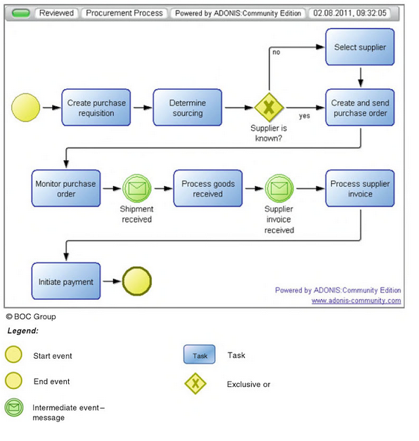
Proses Bisnis : Procurement BPMN
Notes:
contohnya BPMN (Business Process Model and Notation)

Slide 8
Proses Bisnis: Narasi Penjualan Smartphone
Input | Functional Area Responsible for input | Process | Output
Permintaan pembelian smartphone | Marketing and Sales | Menerima pesanan penjualan | Permintaan dihasillkan
Bantuan pembiayaan dalam pembelian | Accounting and Finance | Pengaturan pembiayaan dari internal perusahaan | Pelanggan dibiayai dari perusahaan smartphone
Penyelesaian Permintaan | Supply Chain Management | Pengiriman | Pelanggan menerima smartphone
Technical Support | Marketing and Sales | Dukungan Konsumen: Bantuan telpon 24 jam | Kebutuhan teknis pelanggan selesai

Slide 9
Fungsi Bisnis vs Proses Bisnis
Menyelenggarakan perusahaan sesuai garis area fungsional
Menyelenggarakan perusahaan dengan optimalisasi proses bisnis lintas area fungsional

Slide 10
Indentifikasi: Apakah Fungsi Bisnis atau Proses Bisnis
Berdasarkan proses bisnis penjualan smartphone, terjadi kasus smartphone rusak karena proses pengiriman. Pelanggan melakukan penembalian. Proses penerimaan pengembalian barang dilakukan oleh satu area fungsional, yaitu Marketing and sales khususnya bagian Customer Relationship Management. Proses penerimaan pengembalian barang adalah fungsi bisnis dari Marketing and sales. Penanganan smartphone rusak diikuti oleh proses perbaikan, dan proses pengiriman kembali ke pelanggan, yang dilakukan oleh Supply Chain Management.
Berapa area fungsional yang terlibat? Apakah narasi tersebut fungsi bisnis atau proses bisnis?

Slide 11
Proses Bisnis: Narasi Penanganan Smartphone Rusak
Input | Functional Area Responsible for input | Process | Output
Pengembalian smartphone | Marketing and Sales | Menerima pengembalian barang | Pengembalian dihasillkan
Penyelesaian Pengembalian | Supply Chain Management | Perbaikan | Penyelesaian atas perbaikan dihasillkan
Penyelesaian Perbaikan | Supply Chain Management | Pengiriman | Pelanggan menerima smartphone
Proses lintas area fungsionalitas
>> Proses Bisnis

Slide 12

Proses Bisnis di
Sebutkan nama proses Modul MySAP ERP Ada di halaman berapa pada Modul SAP 01
Logistics Module
Procurement (Material Management MM)
Sales Order Management (Sales & Distribution SD)
Production
Financial Module
Financial Accounting (FI)
Controlling (CO)
Human Resource Module

Slide 13
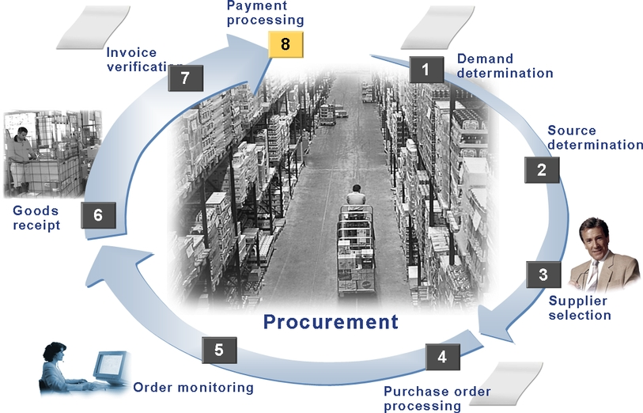
Bisnis Proses: Procurement
Unit: Accounting
Exercise 5-2
Unit: MM Logistics
Invoice Verification
Exercise 4-3
Unit: MM Purchase
Doc: Purchase Requisition
Unit: MM Purchase
Doc: Request For
Quotation
Unit: MM Inventory
Doc: Good Receipt
Exercise 4-2
Unit: MM Purchase
Doc: Quotation
Unit: MM Purchase
Doc: Purchase Order
Exercise 4-1
Unit: MM Purchase
Doc: Order Acknowledement
Notes:
Tidak perlu dibahas per proses, karena akan dibahas pada pertemuan khusus

Slide 14
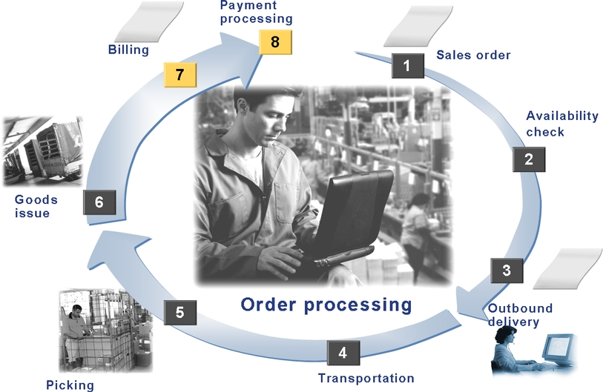
Bisnis Proses: Sales Order
0. Pre Sales Activity
Doc: Inquiry, Quotation
Exercise 5-3
Exercise 4-6
Doc: Sales Order
Exercise 4-4
Doc: Good Issue Doc
Exercise 4-5 no.2
Doc: Transfer Order
Doc: Delivery Order
Exercise 4-5 no.1
Notes:
Tidak perlu dibahas per proses, karena akan dibahas pada pertemuan khusus

Slide 15
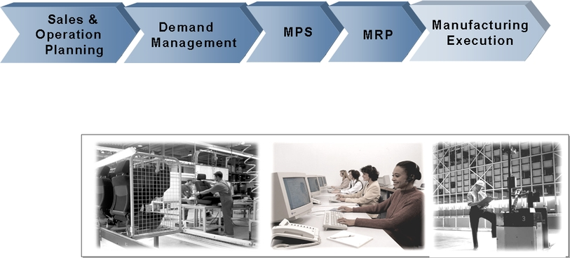
Bisnis Proses: Production Planning
Notes:
Tidak perlu dibahas per proses, karena akan dibahas pada pertemuan khusus

Slide 16
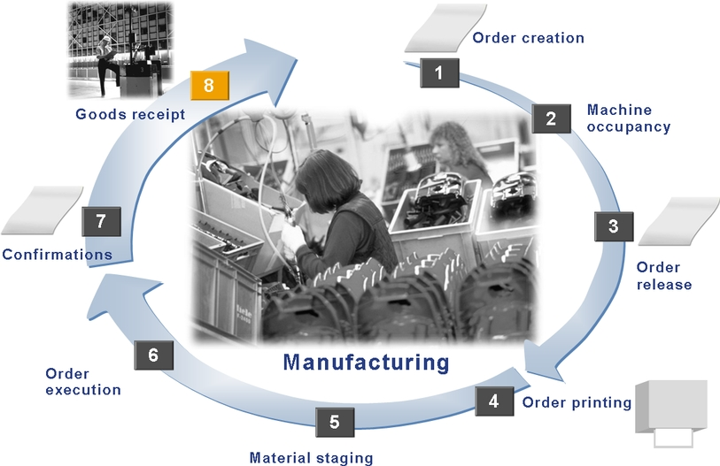
Bisnis Proses: Production
Unit: Planning
Exercise 4-9 no 1. a-g
Unit: Warehouse
Unit: Planning
Unit: Warehouse
Exercise 4-9 no 3
Unit: Planning
Exercise 4-9 no 1.h
Unit: Shop Floor Control
(org lapangan)
Unit: Shop Floor Control
(org lapangan)
Unit: Shop Floor Control
(org lapangan)
Exercise 4-9 no 2
Notes:
Tidak perlu dibahas per proses, karena akan dibahas pada pertemuan khusus

Slide 17
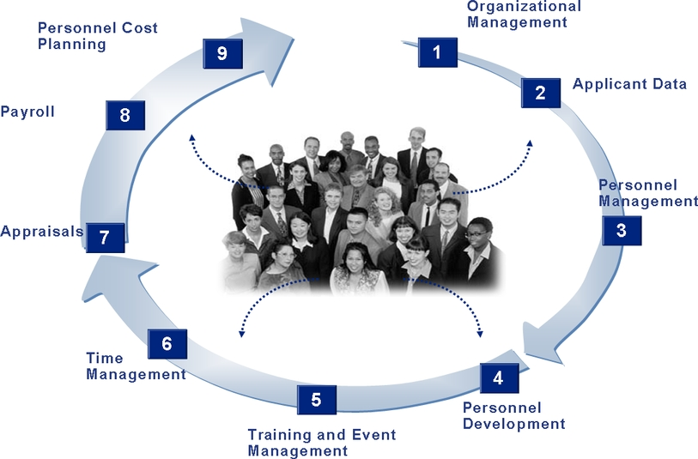
Bisnis Proses: Human Capital Management
Notes:
Tidak perlu dibahas per proses, karena akan dibahas pada pertemuan khusus

Slide 18
Unit 3: System Wide Concept
Notes:
Mahasiswa membuka modul SAP01

Slide 19

Unit 3: System Wide Concept
Lesson: System-wide Concept
Organizational Element
Master Data
Transaction

Slide 20
Organizational Element
A company’s enterprise structure is mapped to SAP application using organizational element. (SAP,2006)
The mechanism for defining a company’s enterprise structure within the SAP system for legal and/or business-related purposes. (Yayan, 2009)

Slide 21
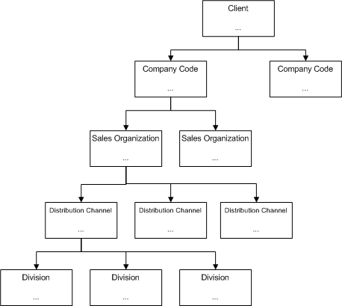




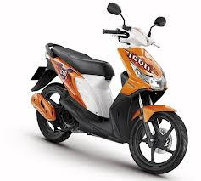
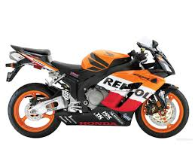
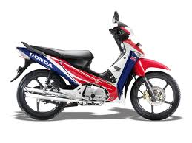
Organizational Element SALES and DISTRIBUTION
Client ← Highest hierarchical level in SAP
Company Code
x
Sales Organization
x
Distribution Channel
dealer
Division
matic
sport
bebek
Notes:
Jelaskan masing-masing Organizational Element!
Client = The highest level element of all organizational elements. (keyword: headquarter)
contoh: Astra Internasional
http://www.astra.co.id/
Company Code = A legal accounting unit representing the central organizational element of financial accounting.
The company code also represents the tax law(national), view of the company, the fiscal calendar, the local currency and
the tax reporting requirements. (keyword: punya NPWP)
contoh: anak perusahaan astra PT Astra Honda Motor (AHM)
contoh lain:
Otomotif: PT Astra Otoparts Tbk, PT Astra Honda Motor (AHM), PT Toyota-Astra Motor (TAM), dll
Keuangan: PT Bank Permata Tbk, dll
Alat Berat: PT United Tractors Tbk , dll
agribisnis: PT Astra Agro Lestari Tbk , dll
IT: PT Astra Graphia Information Technology, dll
http://www.astra.co.id/index.php/business/detail/42
Sale Organization = The central organizational element in sales order management that controls the terms of sale to the customer.
Bisa dalam bentuk regional, nasional, devisi internasional.
Hak:
Mendistribusikan barang dan jasa
Menetapkan ketentuan penjualan
Penanggung jawab produk dan pemberi asuransi produk
cth. PT Astra Honda Motor (AHM)
http://www.astra-honda.com/index.php/hargamotor
Distribution Center =distribution channels can be used to define how different products reach consumers.
Cara/strategi produk sampai ke customer
Cth. wholesale/distributor/grosir, internet, industrial consumption, direct sales
Cth. Distribusi AHM melalui Astra Motor dengan cara dealer dan retail.
http://maindealer.astramotor.co.id/profile#history
Division = You can use divisions to organize materials or services, for example to form product groups or lines.
The division establishes responsibility for profits from materials and services.
Division tidak harus ada, jika tidak ada pembagian material/servis, tetap harus dibuat division dummy (devision 00) http://help.sap.com/saphelp_46c/helpdata/en/1d/0c06757ec311d29c570000e8a51c6e/content.htm
Lini produk
Cth. motor, spare parts, jasa dll
Cth. Astra Motor memasarkan motor: matic, sport, bebek
Add link: http://help.sap.com/saphelp_40b/helpdata/en/dd/55f3a4545a11d1a7020000e829fd11/content.htm

Slide 22
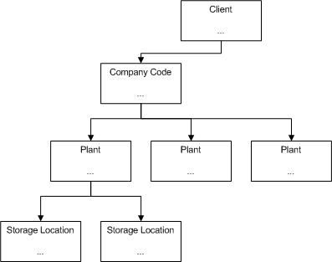
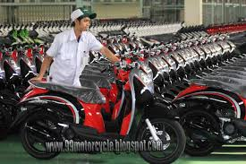
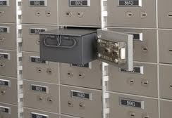
Organizational Element Material Management
Client
Company Code
02:
Pegangsaan Dua
03:
Cikarang Barat
Plant
01: Sunter
Storage Location
Notes:
Plant = a plant can manufacture product, distribute product, or provide a service.
cth. AHM punya 3 fasilitas pabrik perakitan
http://www.astra-honda.com/index.php/about/index/2
Storage Location = It is a place where stock is physically kept within a plant. (keyword: tempat menyimpan produk)
cth. Simpan mobil → gedung
Simpan laptop, komputer, spare part → rak
Simpan berlian → box
Simpan dokumen →box
Add Link: http://insidesap.wordpress.com/2011/11/15/mm-structure/

Slide 23
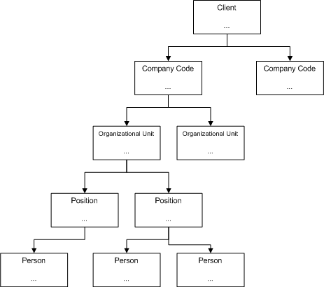
Organizational Element HUMAN RESOURCE
Client ← Highest hierarchical level in SAP
Company Code
Organizational Unit
Plant
HR
Position
Plant manager
Production engineer
Person
Notes:
Organizational Unit = organizational units describe the various business units that exist in an enterprise. Often units are loosely defined as functional or regional departments.
cth. HR, Marketing, Finance, Plant
Job = are classifications of functions in an enterprise which are defined by the assignment of characteristics.
cth. Manager, Engineer, Consultant , Designer, Administrator
Position = positions are the individual employee assignments in the enterprise.
Represents a post that can be occupied by a person (employee) in the staff assignments of an organizational unit.
cth. HR/Marketing/Finance/Plant manager, Production/Site/Software engineer, SAP HR/FI/CO/SD consultant, Software/Web designer
http://sapfunctional.com/HCM/OrgStructure/Page1.htm
Add: http://sapfunctional.com/HCM/OrgStructure/Page1.htm

Slide 24
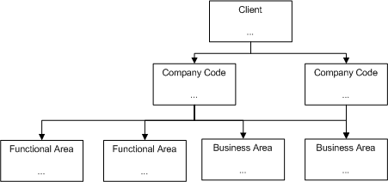
Organizational Element FINANCIAL ACCOUNTING
Client ← Highest hierarchical level in SAP
Company Code
Business Area
Functional Area
Notes:
Business Area =
-reporting purpose (laporan keuangan = B/S dan P/L)
Penanggung jawab perubahan nilai di laporan keuangan. (specific business segment or area of responsibility eq. Business areas can be identified based on the products of the company or based on geographical area or a business unit of a company. )
Cth. For example Vehicle is a business area in a company. Vehicle can be cars and Bikes etc. Here Vehicle is business area and Cars and Bike are profit centers.
Functional Area =
-Reporting purpose P/L berdasarkan cost of sales
Organize our business for cost of sales accounting.
Classify different type of cost within one expense account.
(http://www.elearning.sapcustomization.com/sap-fico/104-sap-e-book/sap-fico-i-book-classic/chapter-3-financial-accounting-sap-fi/chapter-3-1-fi-enterprise-structure/92-overview-of-fi-enterprise-structure.html)
=====
1 business area = n profit center
http://scn.sap.com/thread/482518
http://www.slideshare.net/eddai/sap-fi-configuration-guide
http://www.saptechies.co.in/difference-between-profit-centre-business-area/

Slide 25
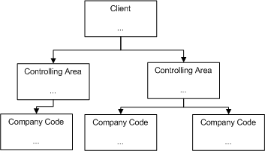
Organizational Element CONTROLLING
Client ← Highest hierarchical level in SAP
Controlling Area
Company Code
CoA
Notes:
Controlling Area (CA) = Cost Accounting Purpose
1 CA = n Ccode (syarat 1 CoA)
1 Ccode = 1 CA
Link http://help.sap.com/saphelp_470/helpdata/EN/08/513f4b43b511d182b30000e829fbfe/content.htm

Slide 26
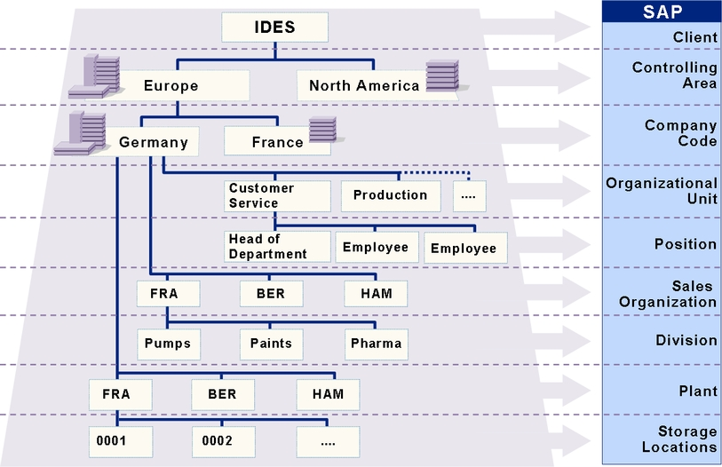
Organizational Structure
Notes:
Organizational Structure contains organizational element. (http://sapfunctional.com/HCM/OrgStructure/Page1.htm)
Organizational element is mechanism for defining a company’s enterprise structure within the SAP system for legal and/or business-related purposes.
SAP enterprise structure is organizational structure that represents an enterprise in SAP R/3 system. (http://wiki.sdn.sap.com/wiki/display/ERPLO/Enterprise+Structure)

Slide 27
Unit 3: System Wide Concept
Lesson: System-wide Concept
Organizational Element
Master Data
Transaction

Slide 28
System Wide Master Data concept
Master data is created centrally and available to all application and all authorized users.
Centrally stored master data means data record are always consistent, up to date and free redundancy.

Slide 29
System Wide Master Data concept
Customer Master
Material Master
Personnel File
Customer Master – Account Receivable
Vendor Master – Account Payable

Slide 30
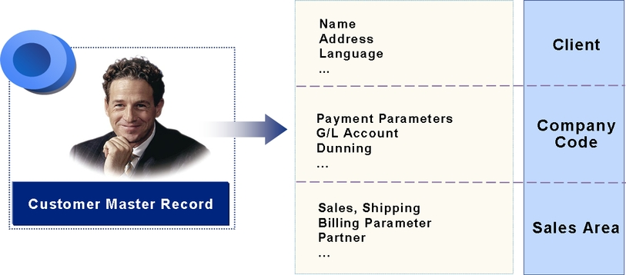
System Wide Master Data concept
Customer Master
Information about relationship between company and its customer
3-part structure:
General Data (Client Level)
Data for company (Company Code)
Data for sales (Sales Ara)
Notes:
3-part structure:
General Data (Client Level) = data relevant to every company code and sales organization
Data for company = codes company’s specific agreement with customer
eg. Payment and dunning
Data for sales = sales organizations and channels characteristics.
eg. Shipping, billing

Slide 31
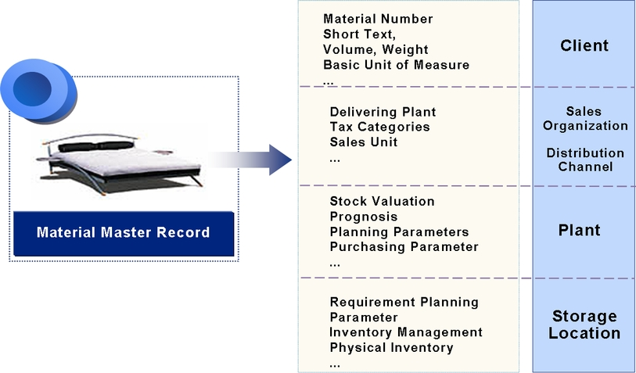
System Wide Master Data concept
Material Master
Information about relationship material within organization
Information group by business function
Note. The majority of the view in a material master are at plant level
Notes:
Plant = secara fisik adalah gedung penyimpanan barang
Di perusahaan tambang, plant adalah tiap site penambangan

Slide 32
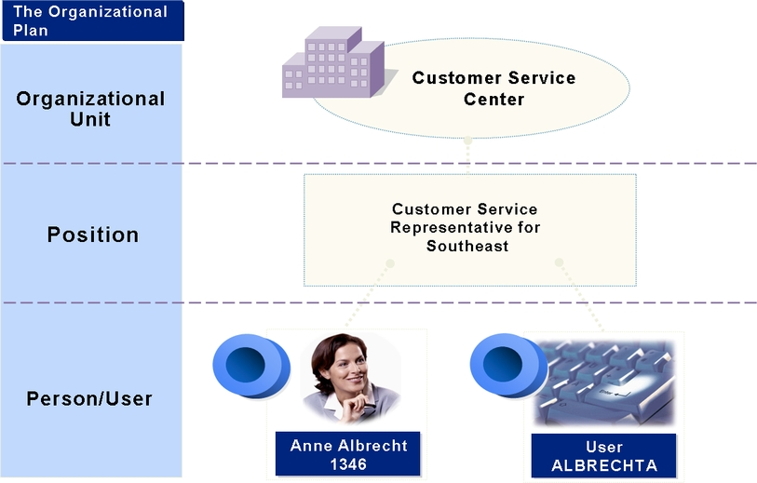
System Wide Master Data concept
Personel Master
Used primarily in mySAP ERP Human Capital
Organizational element referred to Organizational Management.
Organizational management is used to map current organizational and reporting structure.

Slide 33
System Wide Master Data concept
Personel Master
Organizational object:
Organization Unit various business unit (functional or regional department or project group)
Jobs job description/characteristics
Position individual employee assignment. Inherit job characteristics and occupied by person.
Person employee
Identifikasi Contoh:
Manajer?
Manajer Sistem Informasi dan Layanan Akademik?
Manajer HCM dan Manajer Keuangan?
Ka.Prodi?
Ka. Prodi KA?
Magdalena Karismariyanti?
Notes:
Manajer? JOB
Manajer HCM dan Manajer Keuangan? POSITION
Asisten Manajer? JOB
Asisten Manajer Sistem Informasi dan Asisten Manajer Layanan Akademik? POSITION
Ka.Prodi? JOB
Ka. Prodi KA? POSITION
Magdalena Karismariyanti? PERSON

Slide 34
Unit 3: System Wide Concept
Lesson: System-wide Concept
Organizational Element
Master Data
Transaction

Slide 35
Transaction
Definition
Application programs that execute business process in SAP system

Slide 36
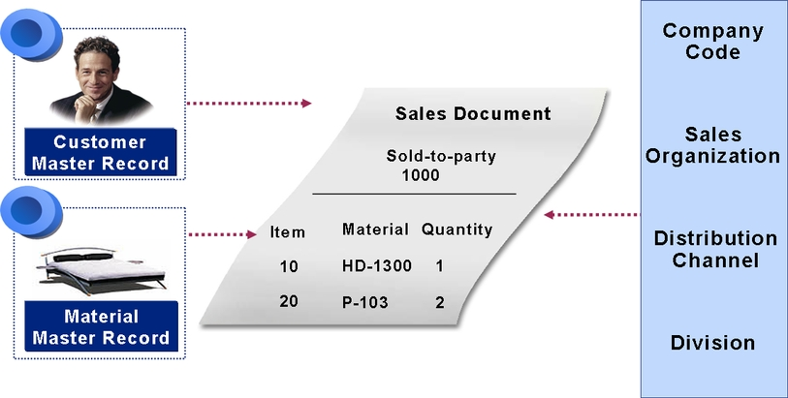
Transaction
When ever possible, master data is copied during transaction processing, thus avoid re-entry of data.
When ever a transaction is executed, a document is created.
Document = data record of transaction (consist of master data and organizational element)
Document

Slide 37
End of This Session

